Slide 1
Topic 4 – Decision Trees
Data Science for Business
Prof: Chris Volinsky
NYU Stern: Spring 2025

Slide 2
Overview
Decision trees are one of the most useful and interpretable ways to build a predictive, supervised machine learning model.
Supervised: there is a very clear, quantifiable target that is of business interest
Predictive: the goal is to make predictions for cases we have not seen yet.
Classification: The target is categorical (typically binary)

Slide 3

Why decision trees
Easy to interpret!
Notes:
Use features to predict targets

Slide 4
Supervised Classification : Basic Example
N
N
Y
Y
Y
N
Y
N
N
Y
N
Y
12 Bank Customers
Target Variable of interest: Did they buy the product?
Attributes we have:
Head: Circle or Triangle
HeadSize: Large or Regular
Body Type: Oval or Rectangle
Body Shading: Light or Dark
Name | Head | HeadSize | BodyType | BodyShading | Buy?
Amy | Round | Regular | Oval | Light | N
Bani | Triangle | Regular | Oval | Dark | N
Crista | Round | Regular | Rectangle | Light | Y
Dev | Round | Regular | Rectangle | Light | Y
Eliza | Round | Regular | Rectangle | Light | Y
Fran | Triangle | Regular | Rectangle | Dark | N
Gianna | Round | Regular | Rectangle | Light | Y
Hector | Round | Large | Oval | Light | N
Irina | Round | Regular | Oval | Light | N
Jaquie | Round | Large | Rectangle | Light | Y
Kendra | Round | Large | Oval | Light | N
LaToya | Triangle | Regular | Oval | Light | Y

Slide 5
Closer look at the data
Features
ID (?)
Target
Name | Head | HeadSize | BodyType | BodyShading | Buy?
Amy | Round | Regular | Oval | Light | N
Bani | Triangle | Regular | Oval | Dark | N
Crista | Round | Regular | Rectangle | Light | Y
Dev | Round | Regular | Rectangle | Light | Y
Eliza | Round | Regular | Rectangle | Light | Y
Fran | Triangle | Regular | Rectangle | Dark | N
Gianna | Round | Regular | Rectangle | Light | Y
Hector | Round | Large | Oval | Light | N
Irina | Round | Regular | Oval | Light | N
Jaquie | Round | Large | Rectangle | Light | Y
Kendra | Round | Large | Oval | Light | N
LaToya | Triangle | Regular | Oval | Light | Y
Instances,
observations
Notes:
Head size, letters in name, height, etc.

Slide 6
Separating Classes
How do we build a model to separate those who buy and those who don’t?
What attributes would you use?
What rules would you make?
What criteria do you use?
How do you determine how good it is?
Name | Head | HeadSize | BodyType | BodyShading | Buy?
Amy | Round | Regular | Oval | Light | N
Bani | Triangle | Regular | Oval | Dark | N
Crista | Round | Regular | Rectangle | Light | Y
Dev | Round | Regular | Rectangle | Light | Y
Eliza | Round | Regular | Rectangle | Light | Y
Fran | Triangle | Regular | Rectangle | Dark | N
Gianna | Round | Regular | Rectangle | Light | Y
Hector | Round | Large | Oval | Light | N
Irina | Round | Regular | Oval | Light | N
Jaquie | Round | Large | Rectangle | Light | Y
Kendra | Round | Large | Oval | Light | N
LaToya | Triangle | Regular | Oval | Light | Y
Notes:
Maybe introduce the concept of baseline…

Slide 7
Separating Classes
N
N
Y
Y
Y
N
Y
N
N
Y
N
Y
12 Bank Customers
Let’s look just at body type:
N
N
N
Y
Y
Y
N
N
Y
N
Y
Y
Notes:
Does it separate well? What criteria do you use?

Slide 8
Separating Classes
N
N
Y
Y
Y
N
Y
N
N
Y
N
Y
12 Bank Customers
What about BodyShading?
Y
N
N
Y
N
Y
N
N
N
Y
Y
Y
Notes:
Which is better? More pure, vs more coverage?

Slide 9
Separating Classes
Lets look deeper at one of the subsets from our first split
N
N
N
N
Y
N
Are there any rules that make sense here?
You can make a rule here that only applies to this subgroup
“recursive partitioning”

Slide 10
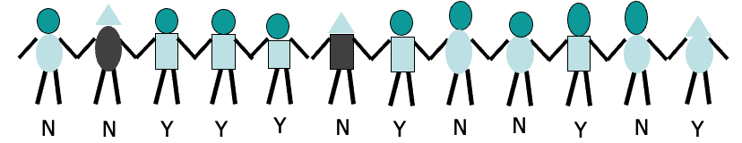
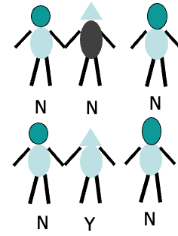
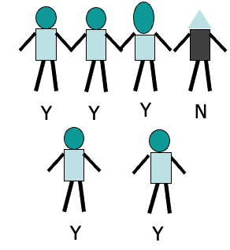
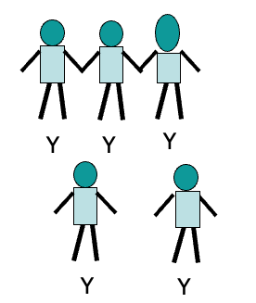
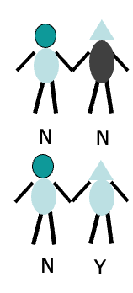
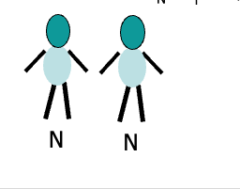
Put it all together
50%
body-shape=oval
body-shape=rectangle
16%
84%
Body-shading=dark
Body-shading=light
Head-size=large
Head-size=normal
N
0%
25%
0%
100%
Notes:
Can we go further?

Slide 11
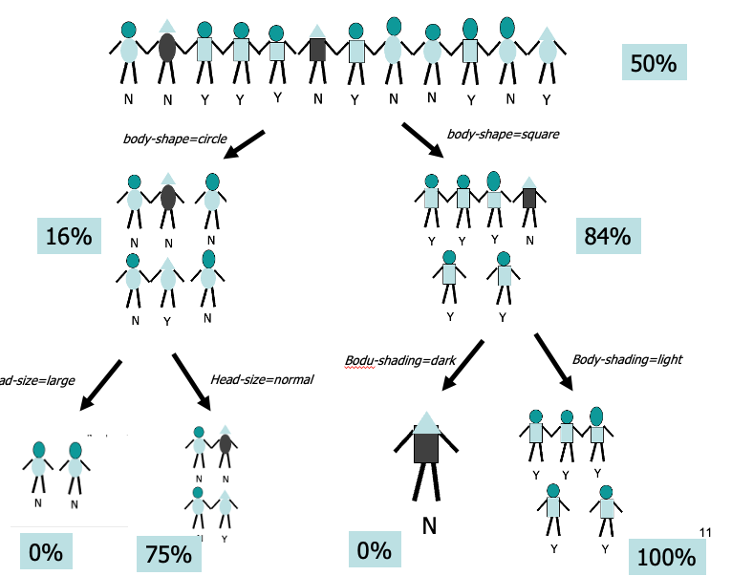
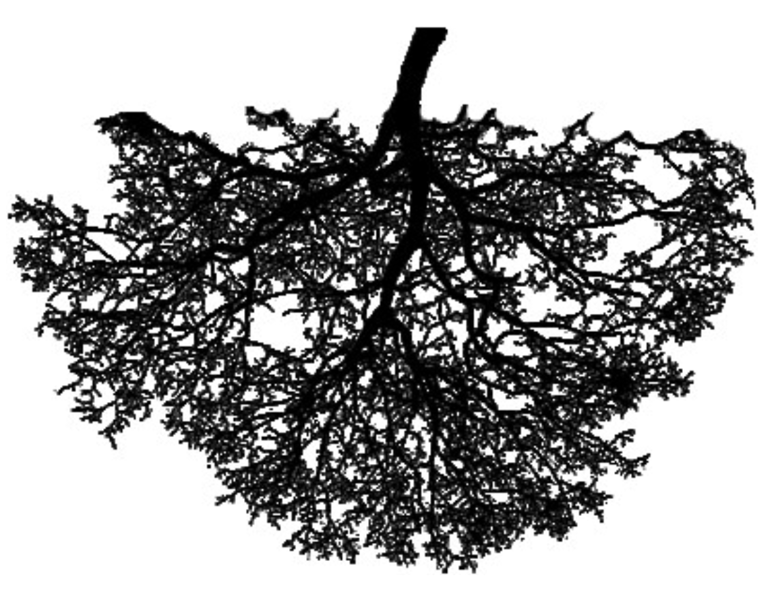
Decision / Classification Tree
This is known as a decision tree or classification tree
Start with all of the data
At each level you create a rule that creates “branches”
Typically 2 branches
Each branch then can get split independently
Each level is defined by a rule
Bottom level are called the “leaves”
Each data point falls in one and only one leaf
Each leaf is defined by a set of rules that got us there
Each leaf gets labelled with the majority class for those that fell in the leaf
New data can now be classified
Every new instance goes to a single leaf
25%

Slide 12
Representing a tree
root
Yes (50%)
body-shape=circle
body-shape=rect
No
Yes
node
Body-shade
=dark
Body-shade
=light
Head-size=norm
Head-size=large
25%
No
No
No
Yes
leaf
What do we predict for this person?

Slide 13
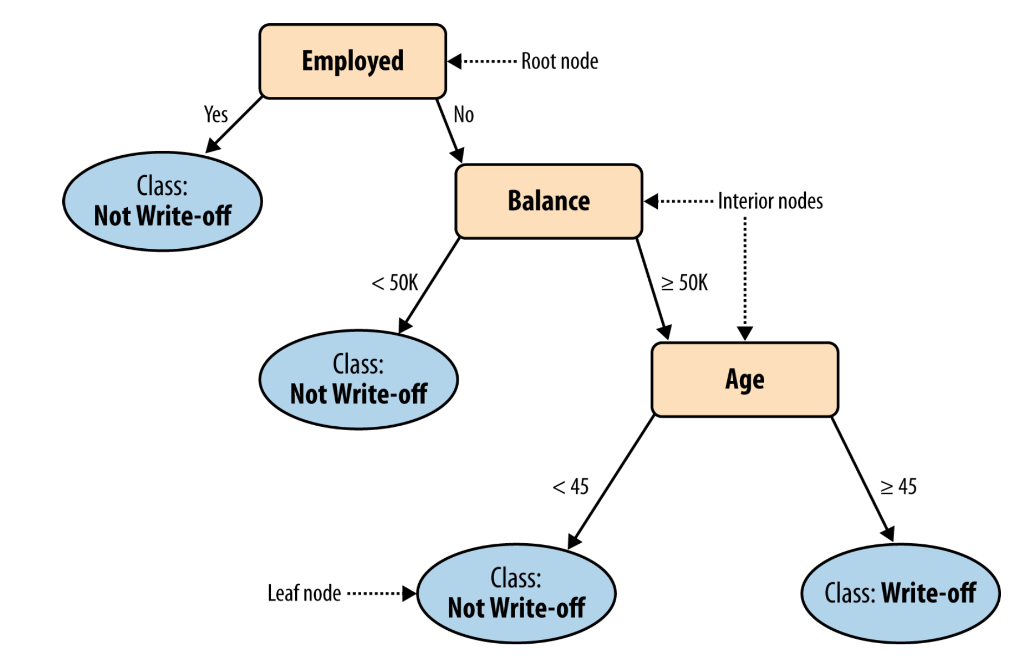
Another example
Model is predicting write-off (default) of a loan from attributes collected on customers
n=50
5Y/45N
Nodes:
Numeric attributes are split at an “optimal” spot
Leafs:
Prediction for a new case is the majority class in the leaf node
n=25
10Y/15N
n=20
5Y/15N
n=25
15Y/10N
Classify Jacob: Balance=115K, 40 years old, not employed
Notes:
You should be able to read and interpret a tree model…

Slide 14
Class Probabilities
Classify Jacob: Balance=115K, 40 years old, not employed
n=50
5Y/45N
We can also assign him a class probability from the leaf node he falls into
Trees assign probabilities by looking at the proportion of the training labels that fell into each leaf node.
n=25
10Y/15N
n=20
5Y/15N
n=25
15Y/10N
Jacob: P(write-off) = 5/20 = 0.25
Q: what if Jacob finds a job? How does his prob change?
Notes:
15/20 = 75%

Slide 15
Using the tree in practice
Remember the flow…
Mark, age 40, works for CitiBank, balance 88K.
The example is routed down the tree according to values of attributes tested successively.
At each node a test is applied to one attribute.
When a leaf is reached, the example is assigned to a class or the probability
What if Mark didn’t have a job?
n=50
5Y/45N
n=25
10Y/15N
n=20
5Y/15N
n=25
15Y/10N
Notes:
Now we know the impact of Employment in the model!!!
5/50 = .1
Vs .25

Slide 16
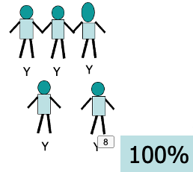
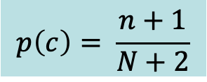
Probability Corrections
We assign each new case the probability of the leaf they fall into
BUT, what if the leaf has 0 or 100% probability?
Laplace correction:
$$p\left(c\right)= \frac{n+1}{N+2}$$
Where n is the number of examples in the leaf belonging to the class
And N is the total number of cases
Laplace correction is often used in cases with small datasets, to offset the impact of “overfitting” (more on this later)

Slide 17
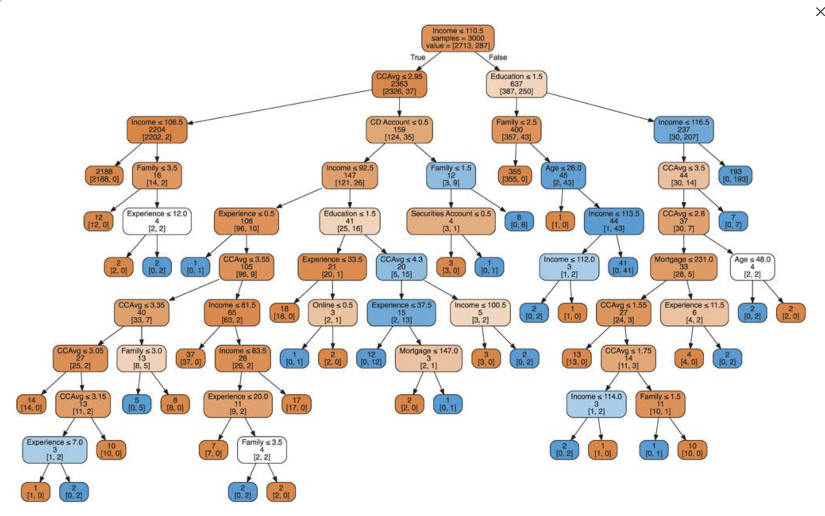
Decision Trees
Loan acceptance (Shmueli 9.3)
The larger you build the tree, the more accurate it gets…
…on the training set 🫤
Applying tree against a test set allows us to determine the optimal depth of the tree to avoid overfitting, and to better estimate the error

Slide 18
Why trees?
Decision Trees are a foundational model for supervised classification
Trees are:
Easy to understand (when small)
Easy to communicate to executives / non-technical stakeholders
Work pretty well for a simple model
Tree induction (from data):
Easy to implement
Computationally cheap for large data sets
Ignores irrelevant variables
Handles missing data well
Doesn’t make any distributional assumptions (normality, etc)

Slide 19
How To Grow Decision Trees

Slide 20
Growing a Tree
Now we know how trees work, but still so many questions!
How do we know which variable to split on ?
How do we know where to split numeric attributes?
How many levels do we build the tree?
How do we evaluate performance?
Algorithms do the work, but we need to make some decisions along the way!

Slide 21
Growing a tree
What makes a good split?
Name | Head | BodyType | BodyShading | Buy?
Amy | Circle | Oval | Light | N
Bertha | Triangle | Oval | Dark | N
Crista | Round | Rectangle | Light | Y
Dante | Round | Rectangle | Light | Y
Eliza | Round | Rectangle | Light | Y
Fran | Triangle | Rectangle | Dark | N
Gianna | Round | Rectangle | Light | Y
Hector | Round | Oval | Light | N
Irina | Round | Oval | Light | N
Jaquie | Round | Rectangle | Light | Y
Kendra | Round | Oval | Light | N
LaToya | Triangle | Oval | Light | Y
Two elements to a good split:
1) “purity” of the branches
2) “coverage” of the data
Notes:
Have them try and answer this question….

Slide 22
1) Measuring Impurity
The more homogeneous (consistent) a group is, the more pure it is
+ good risk – no default
bad risk - default
Very impure group
Less impure
Minimum impurity
Measure this with entropy:
Entropy = - p₁log₂(p₁) - p₂log₂(p₂)
Where p is the probability of a + in that group

Slide 23
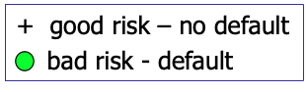
Entropy
+ good risk – no default
bad risk - default

Slide 24
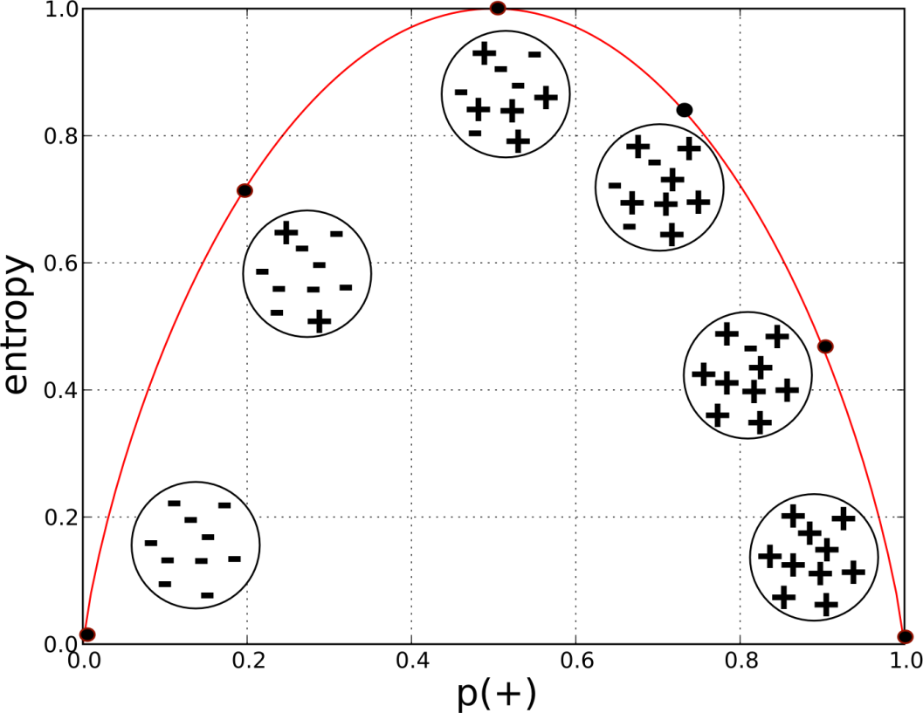
Entropy
Entropy is maximized when classes are equal
Entropy also extends to more than 2 classes

Slide 25
How do we use Entropy?
Split on (Balance > 50K)
Split on (Employed = Y)
Less or equal 50K
Over 50K
Unemployed
Employed
Lower entropy – more information
Notes:
Loan write off example which of these are better

Slide 26
Entropy
Before
A decrease in entropy means more information
After Split
Less or equal 50K
Over 50K
Calculate impurity (entropy) before and after

Slide 27
Evaluate potential split:
Weighted impurity of the children
Entire population (30 instances)
17 instances
Balance>=50K
Balance<50K
13 instances
+ good risk – no default
bad risk - default
Overall entropy of split is a weighted average of the two
Notes:
Started at .96

Slide 28
2) Measuring coverage
Entropy gives us a measure of how helpful a given leaf is in predicting the target
But we need an overall sense of the value of the split!
We want splits that increase our overall information, not just carve off little areas with perfect entropy…
We do this by measuring the overall improvement in entropy across the entire data set for each split:

Slide 29
2) Measuring Coverage
Information Gain = Impurity (parent) – [Impurity (children)]
Gain = 0.38
Impurity(Pre-Split) =0.996
Average Impurity(Post-Split) = 0.615
Balance>=50K
Gain=0.996-0.615=0.38
Impurity = 0.787
Balance<50K
+ good risk – no default
bad risk - default
Impurity = 0.39

Slide 30
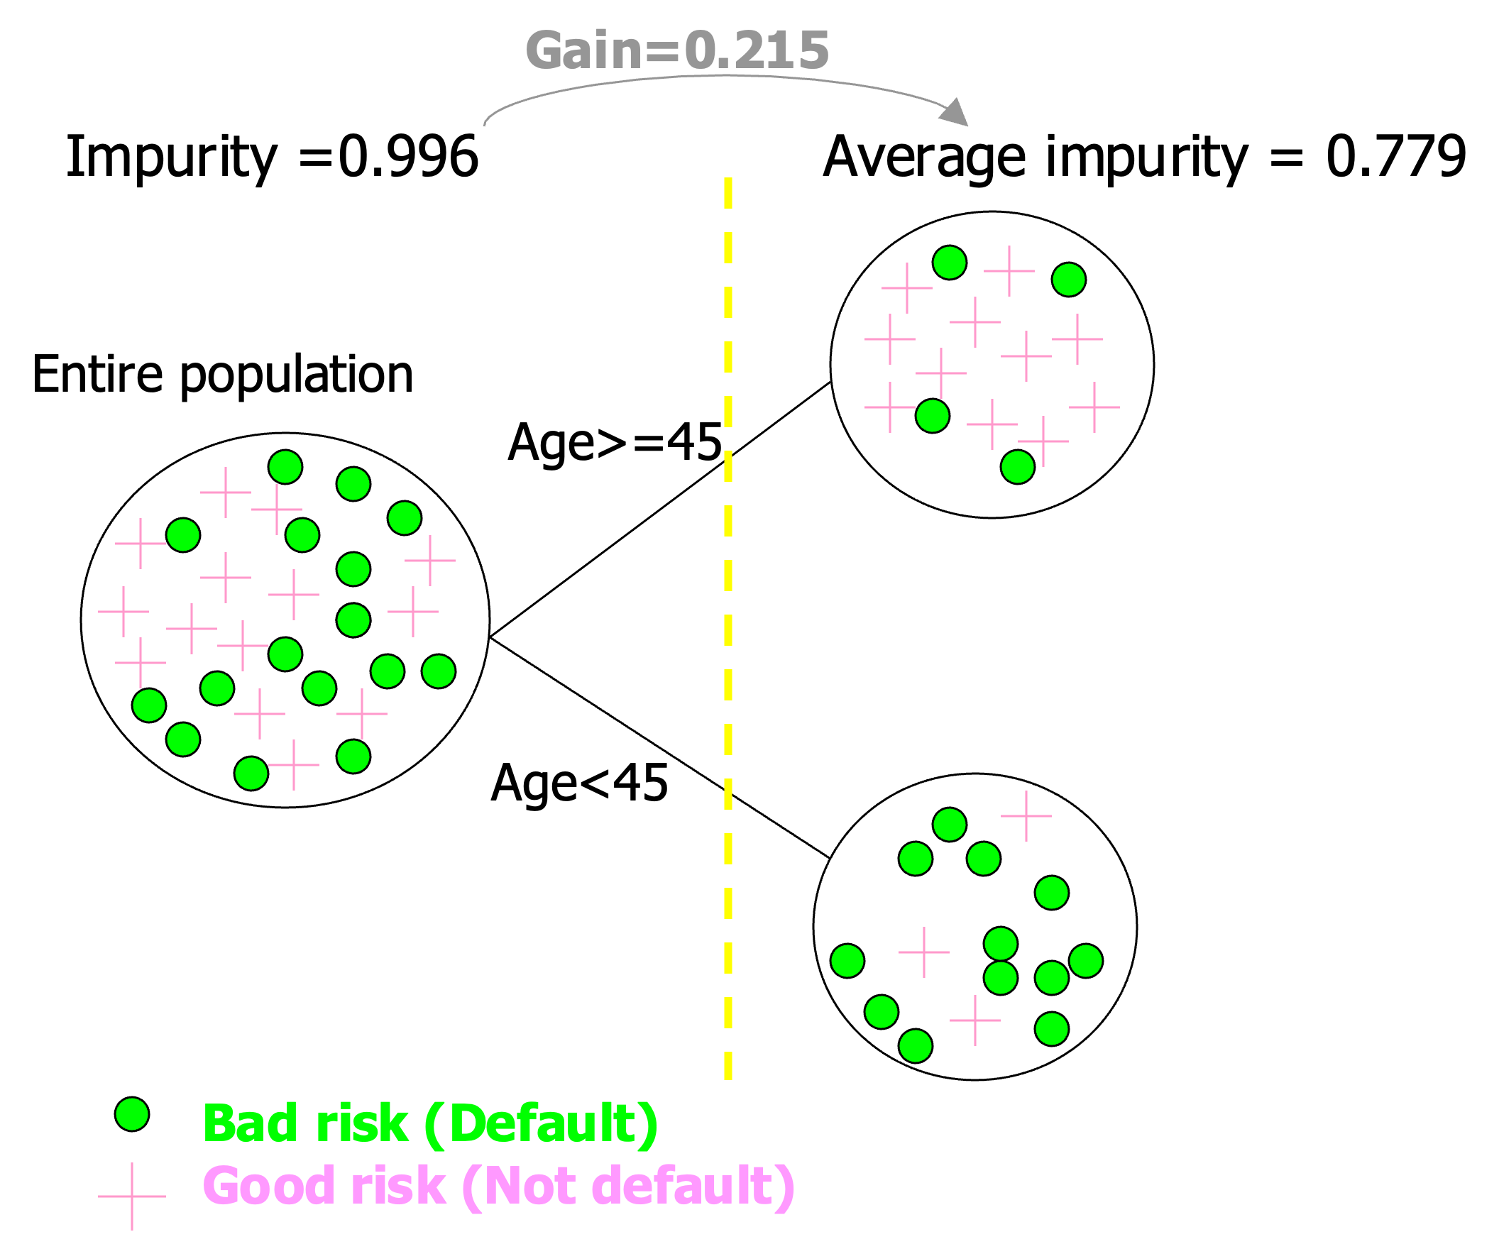
Finding the best split
What if we tried to split over age instead?
Not as good as the split for income!
First, need to find the best place to split the age variable (using information gain)
Then, compare the maximal info gain to other splits
Thankfully we have software to do this!

Slide 31
Finding the best split
At each split, we need to
Find the optimal split point for each numeric attribute
Find the optimal split for any categorical attribute
Compare the information gain of those splits for each attribute
Pick the best one and split

Slide 32

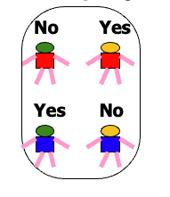
When do we stop growing?
Following the rules above, we can keep splitting and splitting and growing and growing until …
You have perfect purity:
But: we don’t want to grow as far as we can. Why?
Fewer nodes is typically better – more comprehensible, and more accurate
No split can add information:
Test / hold-out sets will guide us in optimal tree size

Slide 33
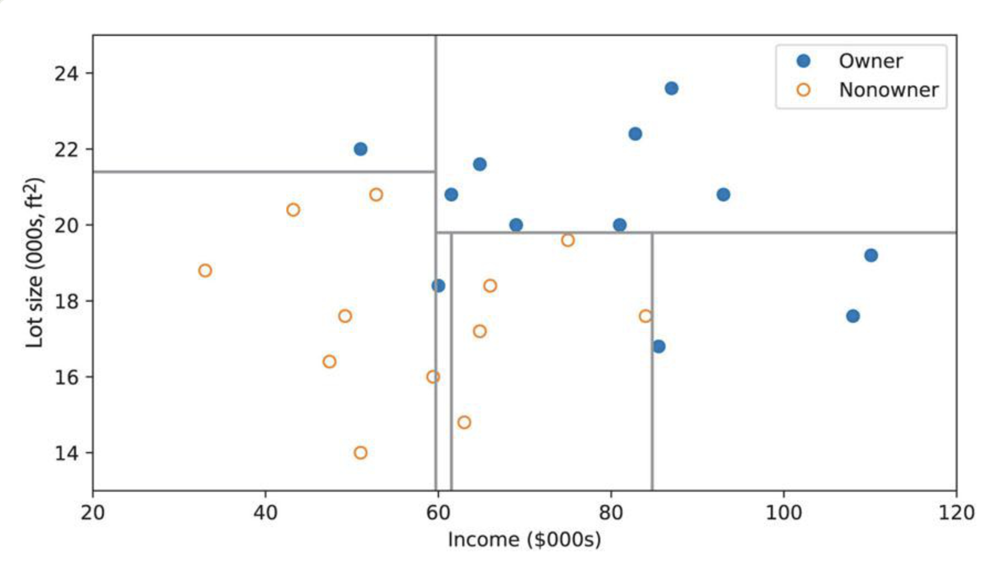
Trees: Geometric Interpretation
Trees create rules that correspond to axis-parallel lines
Riding mower example: Shmueli 9.2
Notes:
This interpretation gets dodgy when you start thinking about more than 2 dimenstions…

Slide 34
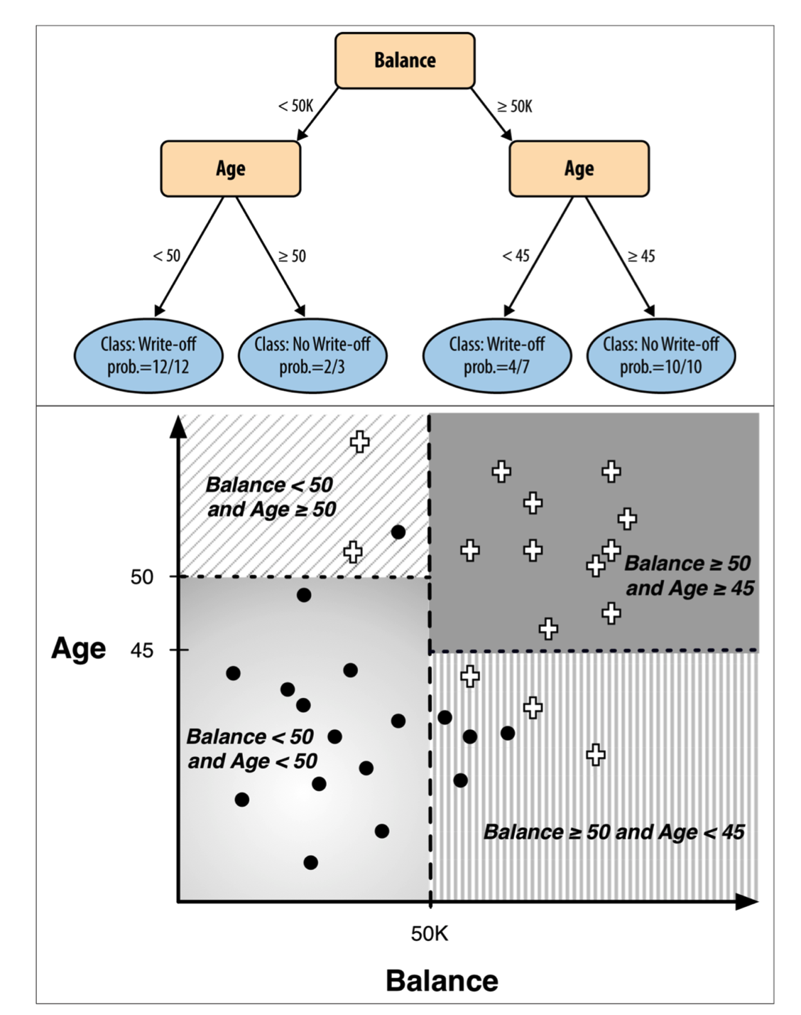
Another Example of Geometric interpretation
Trees split the space with lines that are parallel to the axis

Slide 35
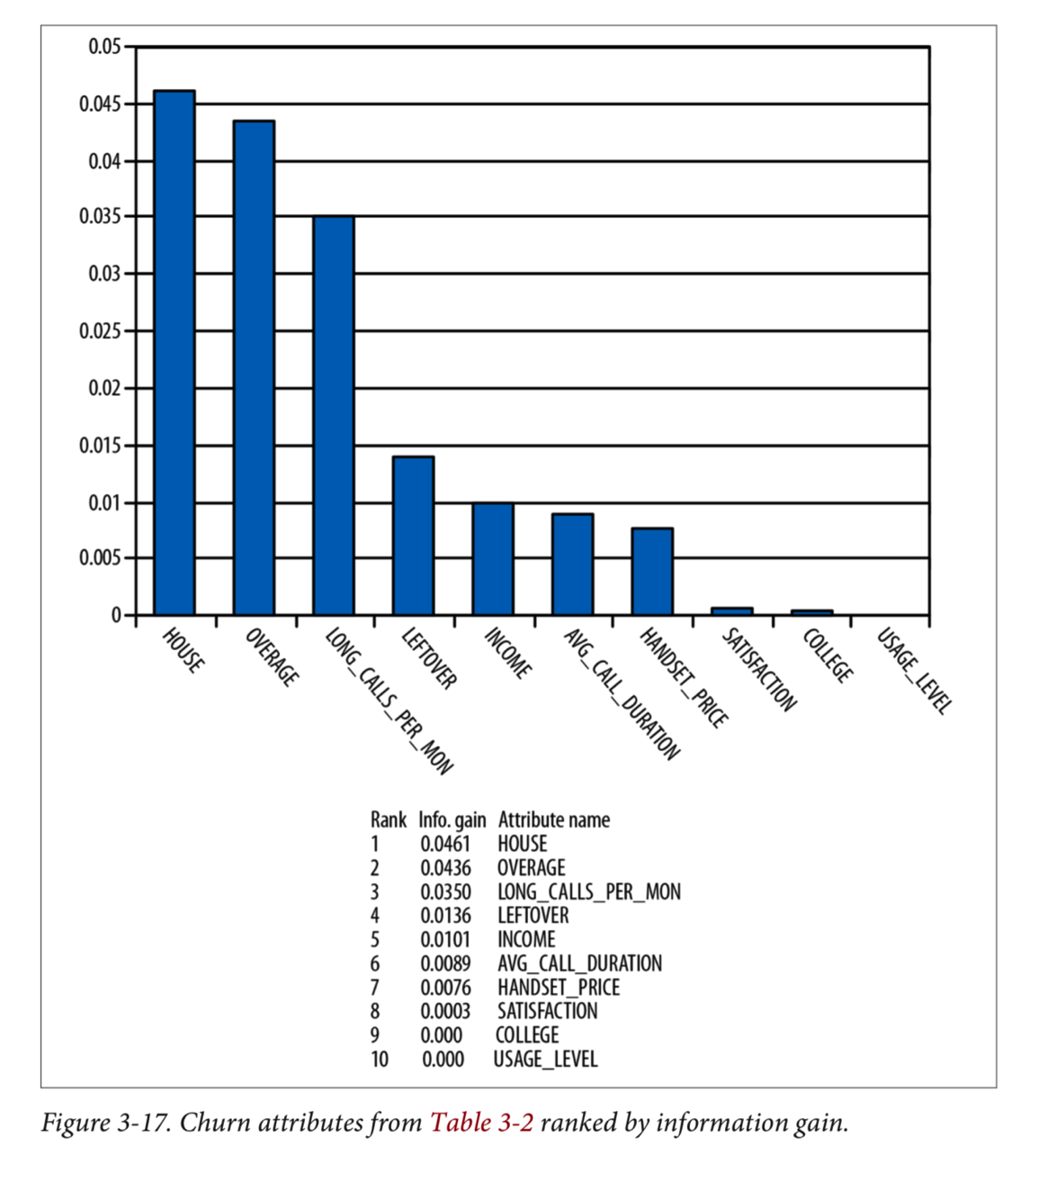
Information gain for insight
DSB Chap 3
Each split results in information gain
Decreasing entropy is increasing information
You can assign the info gain to the attribute used for the split
Information gain gives a measure of feature importance

Slide 36
Tree Summary and Performance
Most basic measure of performance is “accuracy” – strictly how many of your data points you got correct
What is the accuracy in this example? Is that good?
For two main reasons this is not a reliable estimate of “goodness”
Should use a training/test split
Goodness depends on the baserate!
n=50
5Y/45N
n=25
10Y/15N
n=20
5Y/15N
n=25
15Y/10N
Notes:
90/120 = 75%
Overall there are 35Y and 85N = 71%
Use targeting example

Slide 37
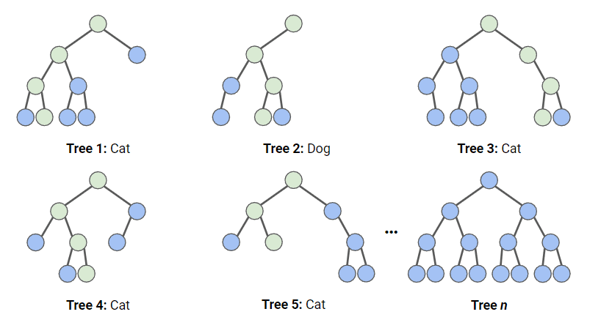
Teaser: Random Forests
Typically, multiple trees (or forests) will outperform a single well-built tree.
Random Forests is a ML method that fits many different trees to a prediction problem - using random samples of rows and columns – and averaging the predictions across trees.
Pro: improved predictive power
Con: loss of interpretability
More to come when we get to ensembles…
from sklearn.ensemble import RandomForestClassifier

Slide 38
Decision Trees : Module
T4_Decision_Trees.ipynb

